Slide 1
ACTION PLAN OUTLINE
TEAM A
CJA/475 – Forecasting and Strategic Planning
November 7, 2016
Robert Powers

Slide 2
City of Kelsey
a better life…
Notes:
Within the Hills of the Northwest Valley lies Kelsey. Kelsey has a population of 625,000 people. You can find the amenities of the big city in Kelsey with the small town charm.
The community is earth-friendly and promotes a better quality of life through service, healthy lifestyles and environmental awareness. Kelsey offers a wide array of dining and shopping experiences, and boasts of having one of the best school districts in the state. However, Kelsey has a crime index total of 50,733. There have been 8,592 Violent Crimes, 42,142 Property Crimes, 319 Forcible Rapes, 3,303 Robberies, 4,859 Aggravated Assaults, 6,429 Burglaries, 29,005 Larceny Thefts, 6,707 Motor Vehicle Thefts, and 112 Murders and Non-Negligent Man Slaughters (University of Phoenix, 2011).

Slide 3

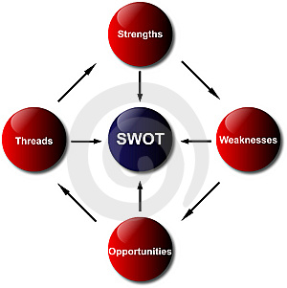
SWOT Analysis Diagram
Notes:
A SWOT Analysis Diagram consists of strengths, weaknesses, opportunities, and threats. SWOT analysis is a strategic planning method used to evaluate internal and external opportunities for projects and programs within institutional organizations, such as the Police Department. SWOT prepares Police Departments with both Internal and External analysis. The internal analysis focuses on the departments strengths and weaknesses. Whereas, the external analysis focuses on threats and opportunities for the Police Department that are out of their control and affects their work ("United Nations Entity For Gender Equality And The Empowerment Of Women", n.d.).

Slide 4
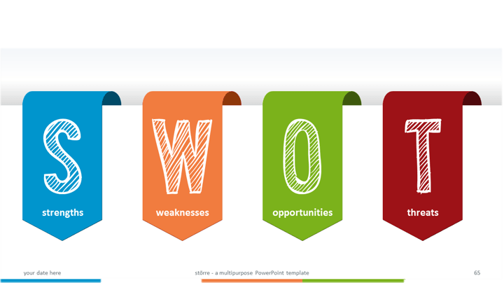
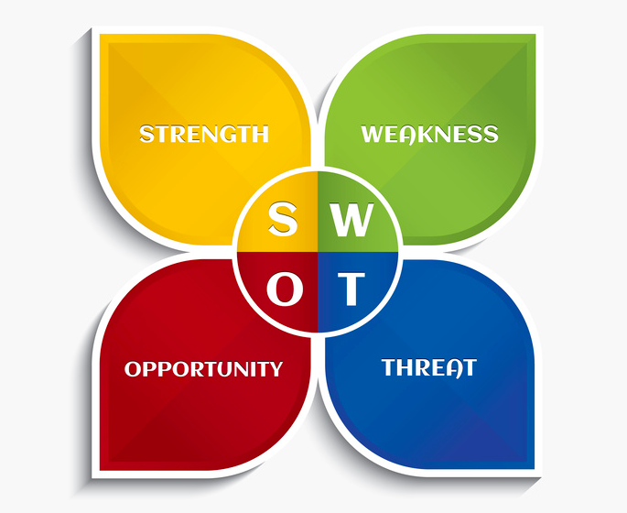
SWOT Analysis
Strengths, Weaknesses, Opportunities, and Threats
Notes:
Positive Factors:
Strengths – Police Department services to community, operating philosophy, and fiscal responsibility and innovative thinking.
Opportunities – Sharing of services, positive and enthusiastic working environment. Work to reduce issues related to crime and fear of crime, and better serve and educate community. Work to make community safer. Establish trust in community, and provide a working environment that instills commitment and desire. Lastly, provide necessary funding to provide necessary services.
Negative Factors:
Weaknesses – Manpower, and lack of cost control.
Threats – Community concerns with safety and crime, budget, funding, and provide more with less.

Slide 5
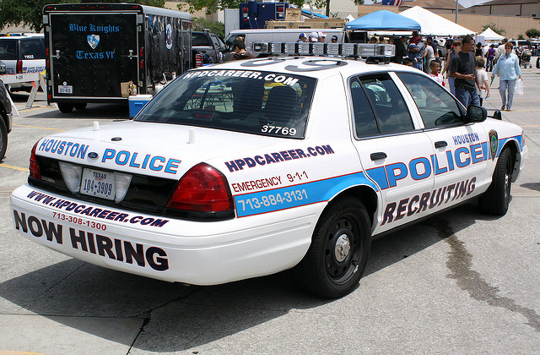
Planned Changes
Crime Rate
Resources
Solution
Notes:
Utilizing SWOT and data that already has been collected, the police department can identify needs in the growing population and crime rates. Kelsey is current crime stats that indicate high rates of violent crime. The violent crime consists of rape, battery and homicide (University of Phoenix). The concern is the already existent elevated crime stats with the projected increase in population. More people will mean a greater chance of crime rate and an increased call for police service volume. The need to increase rank and file police officer is strong and with the influx of incoming citizens the city must take advantage of the incoming revenue generate by the newcomers and increase hiring.

Slide 6

Stakeholder Responsibility
Recruitment
Funds
Resources
Notes:
The term stakeholder is a broad term and can mean anyone who has to gain or benefit from the project at hand. In this case of the police department the stakeholders will be those inside the agency who have endorsed or identified the need for project activity (McMahon, 2013). The police agency leadership must identify the need for more officers through collection of current statistics and projection of future crime stats. The data collected will identify the need for recruitment by the city of Kelsey. The upper level management has the responsibility of identifying the need before it is too late. It takes months to properly train and produce officers not including academy time and recruitment time. The stakeholders must identify this need before through research before the need becomes a problematic reality.

Slide 7

Timeline of Events
Crime data analyzed
Problem areas identified
Proactive Policing/Community involvement
  Zero tolerance policy
Problem area improvement/updating
Assessment of plan effectiveness
Notes:
The first step in improving Kelsey’s crime index is to analyze the crime data. This allows administration to identify crime rich areas and focus more specifically on them. Once problem areas are identified, police administrators deploy specialized task forces to target problem areas. Officers will take a zero tolerance approach and hit criminal offenders hard to get them off the street and deter future crime.
While the task force continues its zero tolerance enforcement, city officials concurrently improve crime rich areas by improving lighting conditions at night, installing surveillance cameras, and partnering with residents and business owners to cooperatively work together to identify offenders.
Lastly, the program will be assessed by comparing the crime index from prior years. This will allow administrators to review the effectiveness of actions taken and alter them as needed.
Image borrowed from: http://www.business2community.com/strategy/aligning-employees-business-strategic-priorities-01083488

Slide 8

Identification of Resources
Legislature
Local business
Federal grants
Private donations
Notes:
There are several resources that will be utilized in order to fund the crime reduction program.
Proposal of a 1% sales or utility tax specifically designed to fund the law enforcement agency. This increase in revenue will be used to fund local area improvements, hire new officers, formulate specialized task forces, and create a community oriented team designed to teach and provide services to the community to identify, target, and deter criminal activity.
All community improvement projects will utilize local businesses. Materials and labor will be obtained via local Kelsey businesses in order to help stimulate job growth and encourage local business success.
Federal grant funding will be sought to help facilitate community improvement measures and fund specialized police teams.
Charity events will be held to seek private donations for funding.
Image borrowed from: https://www.ausm.org/ausm-services/resources.html

Slide 9

Communication Strategies
Cooperation with the community by building trust
Improve communication within the police department
Become involved with other agencies
Notes:
Communication is a key factor in ensuring that the criminal justice system of Kelsey can thrive, and begin to eliminate some of these violent crimes. Having the police department build trust within the community, and become more actively involved will result in greater cooperation from the community as a whole when it comes to reporting crimes when they happen. It is also key that the police department communicate better with it’s own personnel. The officers and managers within the department need to be open with one another if there is any chance of improvement or change.
The department could also benefit from cooperation with other agencies (courts, probation officers, attorneys, etc.) so that they can do their parts in helping reduce the crimes rates as well. (Image borrowed from:http://voyagecontrol.com/index.php/2016/02/23/the-magic-of-communication/)

Slide 10

Conclusion
Main goal is to reduce the crime rate
Implement SWOT within the department
Help create a safer Kelsey
Notes:
The police department’s main goal is to reduce the rate of violent crime. Many factors have been discussed in this presentation about how to reduce that crime rate and keep it down. If the community and the police department, along with other agencies, work together it could result in a safer city for everyone, and the future generations as well. (Image borrowed from: http://acscreations.yolasite.com/portfolio.php)

Slide 11
REFERENCES
McMahon, C. 2013. Business Value Exchange. Roles & Responsibilities of Key Steakholders. http://businessvalueexchange.com/blog/2013/09/17/roles- responsibilities-key-stakeholders/
United Nations Entity for Gender Equality and the Empowerment of Women. (n.d.). Retrieved from http://www.endvawnow.org/en/articles/1055- strengths-weaknesses-opportunities-and-threats-swot-analysis-.html
University of Phoenix. (2011). Virtual Organizations. Retrieved from University of Phoenix, CJA475 - Forecasting and Strategic Planning website.

